Slide 1

Sales Performance Dashboard Overview
Insights into Sales Performance and Customer Behavior
Using AdventureWorks Data
Viktorija Klimoviene

Slide 2
Overview of Sales Performance
Orders count: 31465
Customers count: 19119
Total sales: $ 141 M
AVG order value: $ 4472

Slide 3
Shipping Is Consistently Early
AVG Lead time – 12 days
AVG Shipping time – 7 days

Slide 4
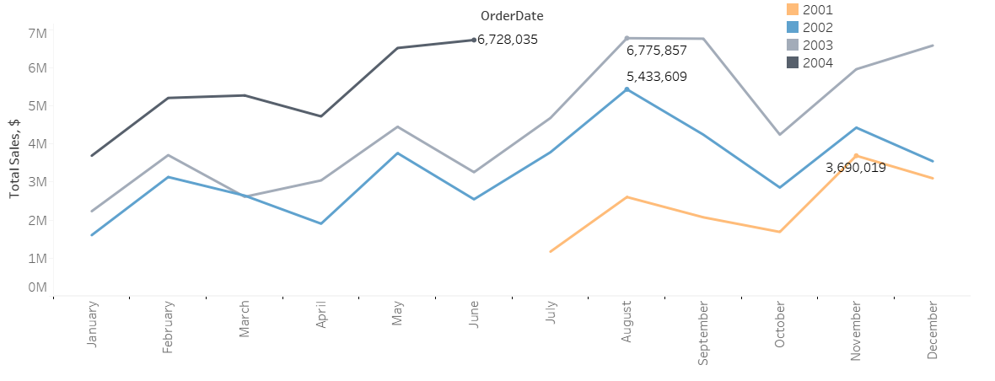
Sales Are Growing Each Year

Slide 5
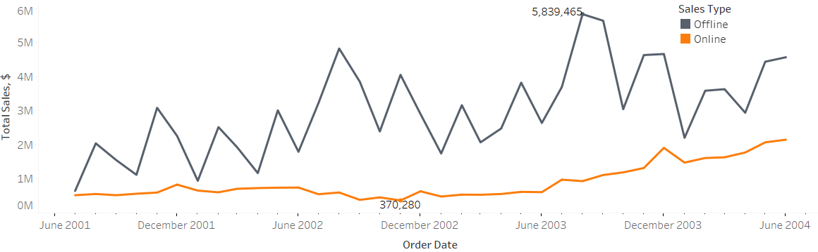
Online vs. In-Store Sales

Slide 6
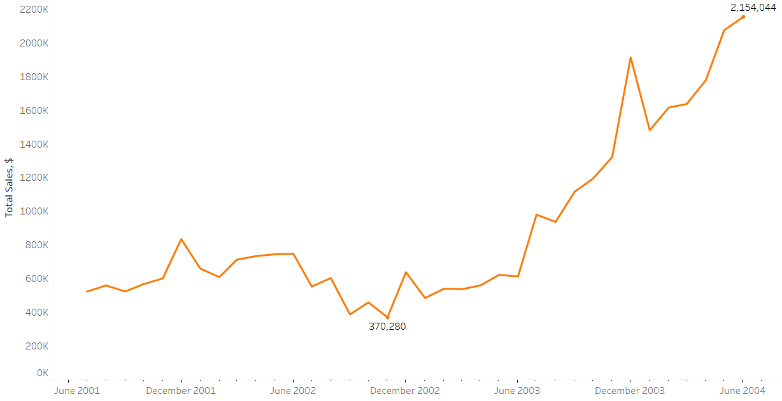
Online Sales Are Growing

Slide 7
Returning Customers Generate Higher Sales
Returning customers – 94,68 % of total sales.
One-time customers – 5,32 % of total sales.

Slide 8
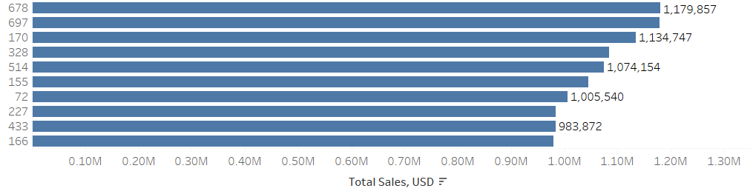
Top 10 Customers to Acknowledge

Slide 9
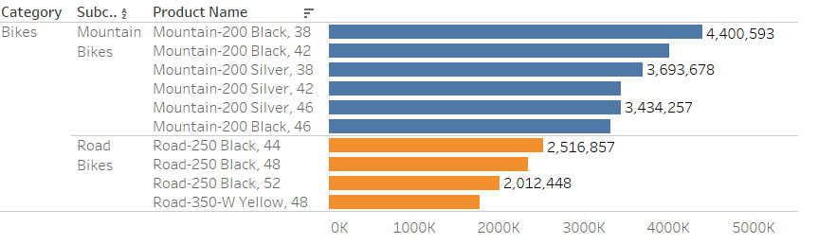
Bikes Are Top Selling Products

Slide 10
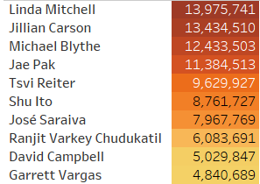
Top Salespeople to Celebrate

Slide 11
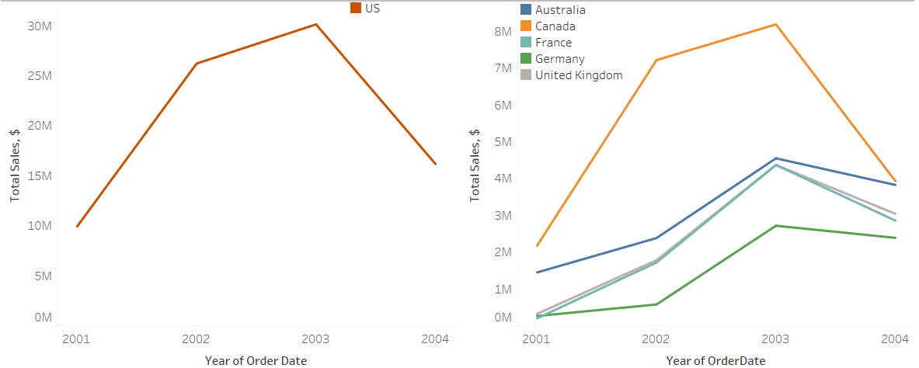
USA Leads in Sales

Slide 12
Summary
Strong Growth – Sales are consistently increasing year over year.
Online Orders Rising: Growth is steady but slow – room for improvement in digital sales.
Returning Customers Spend More: Loyal customers bring higher value.
Top Products: Mountain and road bikes dominate sales.
Top Salespersons: A small group drives a large portion of revenue.
Geographic Trends:USA is the leading market, Canada is showing strong growth, Europe is growing steadily.

Slide 13
Opportunities
Enhance Digital Sales: Invest in online marketing, UX improvements or targeted promotions.
Customer Loyalty Program: Introduce rewards or discounts to retain high-value, returning customers.
Cross-Selling Strategy: Bundle top-selling bikes with accessories (helmets, lights, maintenance kits).
Motivate Sales Team: Consider performance bonuses, recognition, or training for other salespeople.
Regional Expansion: Grow in Canada with local campaigns; boost Europe via partners and events. Good shipping terms could an advantage.

